Slide 1
Service Registration and Discovery
Somaditya Basak

Slide 2
Agenda
Introduction
Problem Statement
Service Registration
Service Discovery

Slide 3



Introduction
Microservice benefits: maintainability, scalability, high availability etc.
Challenges: One of them is to maintain individual microservices locations.
This task is complex in a world where services are deployed in containers.
The service location (host:port) is dynamically assigned and the number of instances changes dynamically based on autoscaling, failure and upgrades.

Slide 4
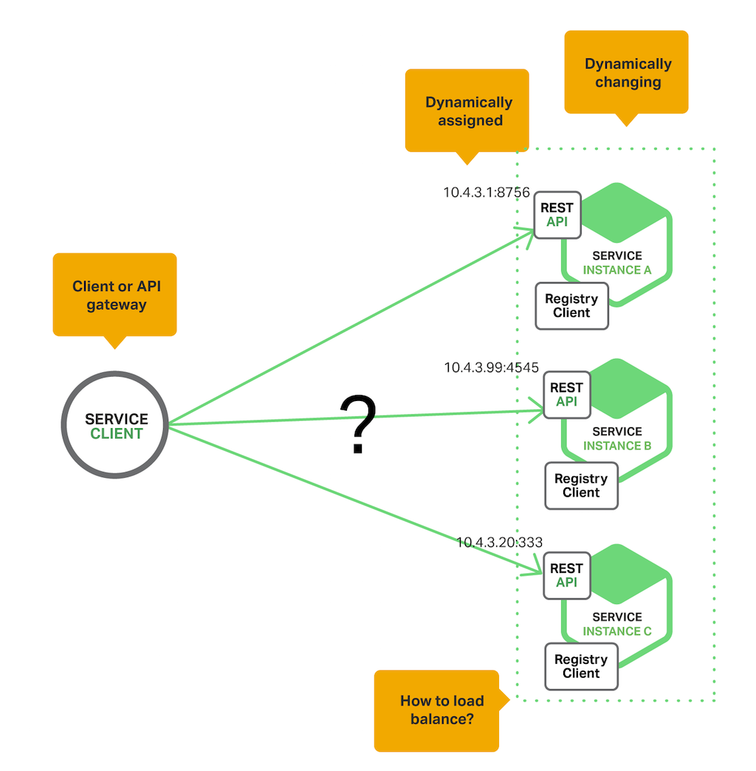
Problem Statement

Slide 5
Problem Statement
Without Service Registration
With Service Registration
Let us assume a project involves 20 or more microservice backends.
There is one Angular UI service that uses all the other backend microservices.
Any change in any of the service location will require code changes in the UI layer.
Clients register with a discovery server.
Discovery server will provide a single point of communication for all services.
All UI requests will go through only one discovery server.

Slide 6
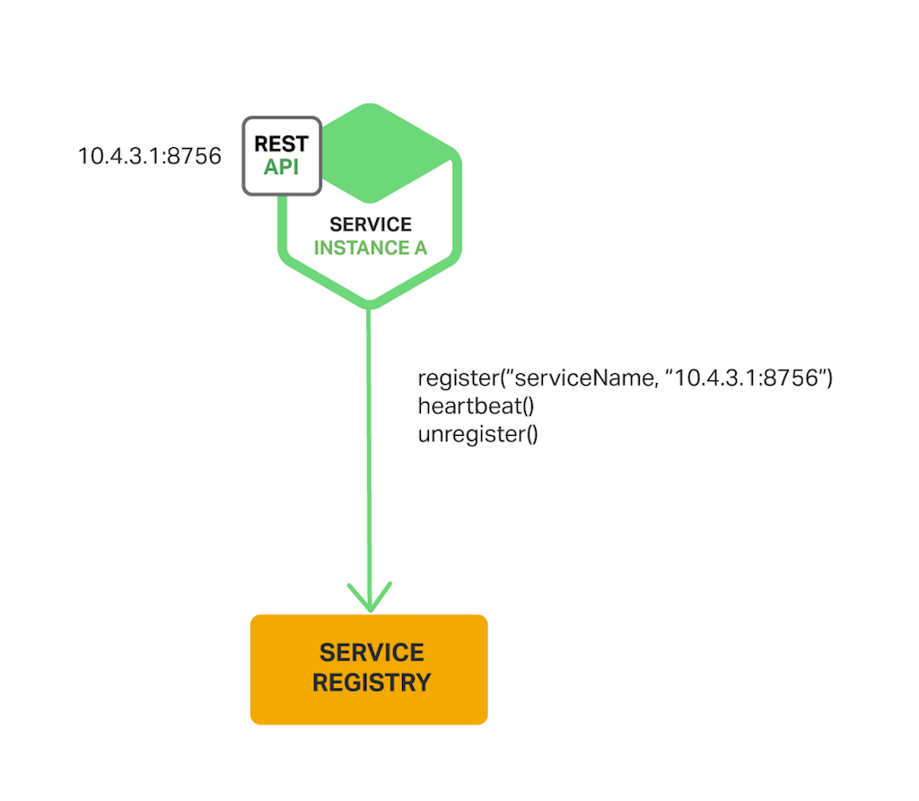
Service Registration
In the self‑registration pattern, a service instance is responsible for registering and deregistering itself with the service registry.
E.g., Netflix Eureka Client, Feign Client
It provides a REST API for registering and querying service instances.
Spring Cloud project makes it easy: simply annotate the Java Configuration class with @EnableEurekaClient annotation.

Slide 7
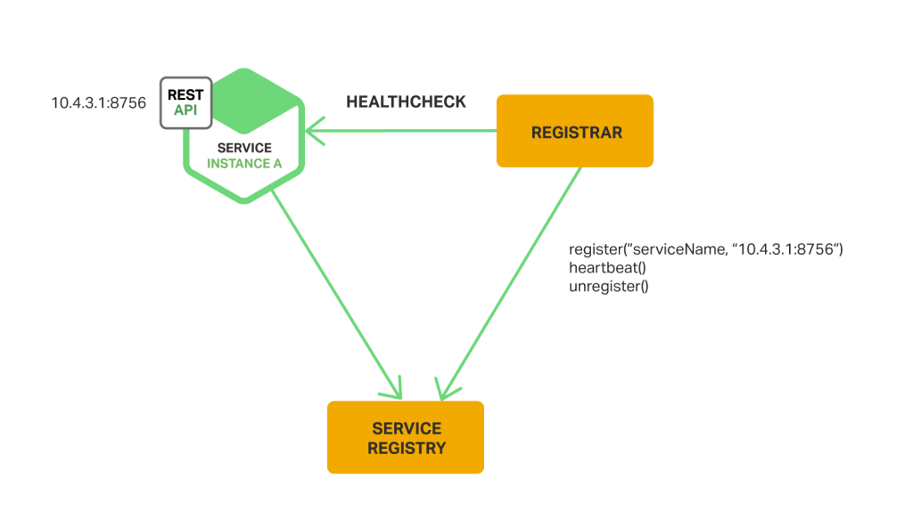
Third‑Party Registration Pattern

Slide 8

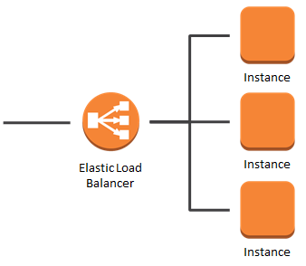
Service Discovery Patterns
Client-Side Discovery
The client is responsible for:
determining the network locations of available service instances
load balancing requests across them.
Server-Side Discovery
The client makes a request to a service via a load balancer.
The load balancer queries the service registry and routes each request to an available service instance.

Slide 9
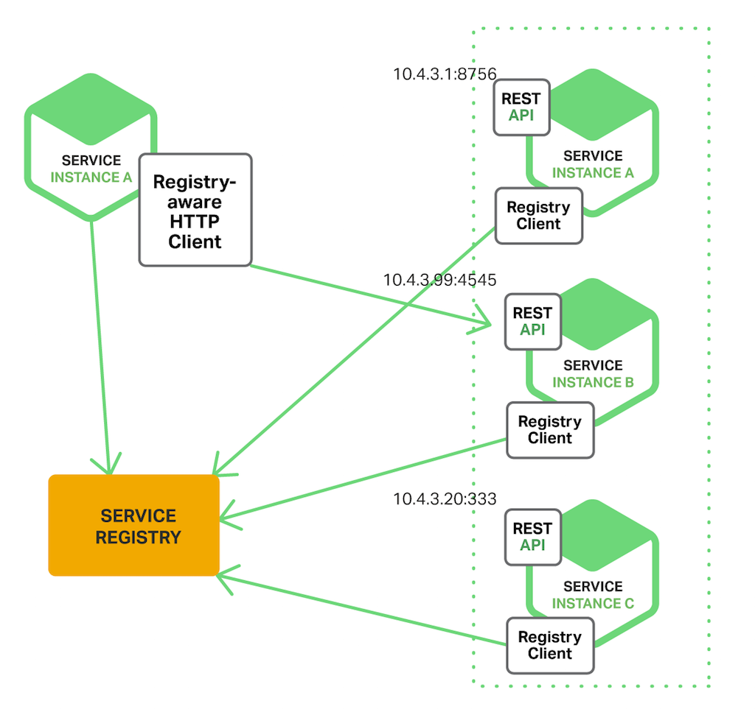
Subtitle
Client-Side Discovery

Slide 10
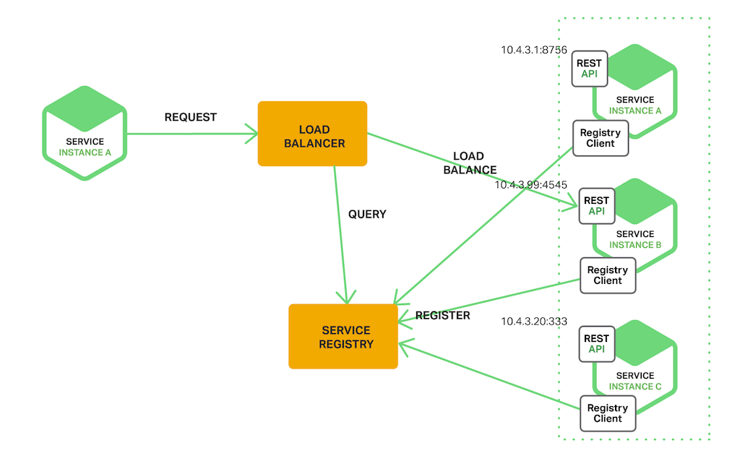
Server-Side Discovery

Slide 11
Service Discovery Patterns
Client-Side Discovery
Server-Side Discovery
The client queries a service registry, which is a database of available service instances.
The client then uses a load‑balancing algorithm to select one of the available service instances and makes a request.
The service instance’s registration is typically refreshed periodically using a heartbeat mechanism.
E.g., Netflix Eureka
The load balancer queries the service registry and routes each request to an available service instance.
As with client‑side discovery, service instances are registered and deregistered with the service registry.
E.g., AWS Elastic Load Balancer (ELB)

Slide 12
Code walk-through
Discovery Server
Client Services
Configuration
Annotations

Slide 13
Thank you
Somaditya Basak
somaditya.basak@amdocs.com
Code repository: https://gitlab.corp.amdocs.com/somaditb/service-registration-discovery

